Slide 1


AI Workforce and Carbon Footprint Optimization Platform
CARBONILE
By

Slide 2


Problem Statement:
“Optimize Workforce task assignments to enhance productivity while minimizing carbon emissions through data driven insights.”
Context:
1
Business Pressure
2
Industry: Cement Statistics
Production
Profits
Sustainability
Human only, Machine only, Collaborative
China 50% of the world
Nigeria 60%
7-8% of world carbon emmissions
3
Advanced Analytics & AI
4
UN SDGs
Decent work
Responsible production
Climate action
Task allocation efficiently
Monitoring
Measurable (ESG reports & government regulations)
Profit Maximization
Reputation

Slide 3
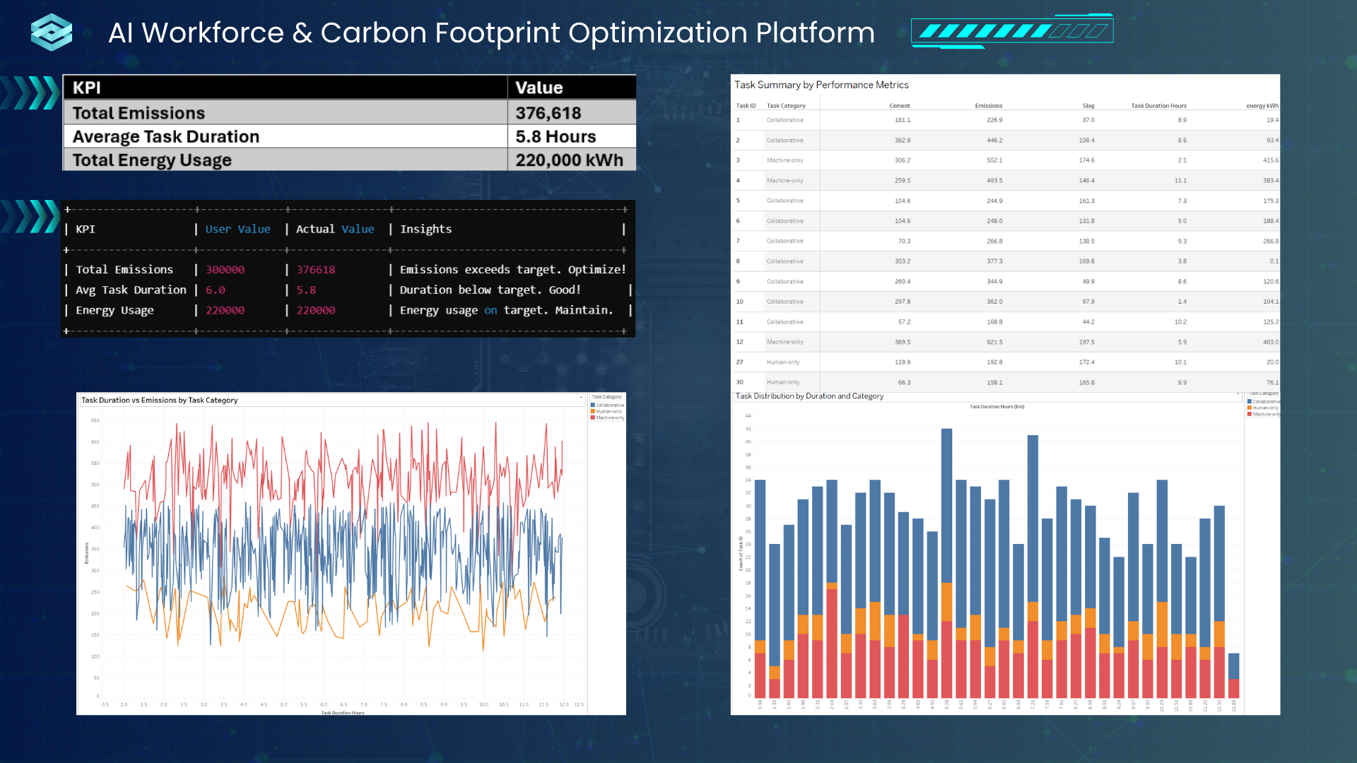
MVP

Slide 4
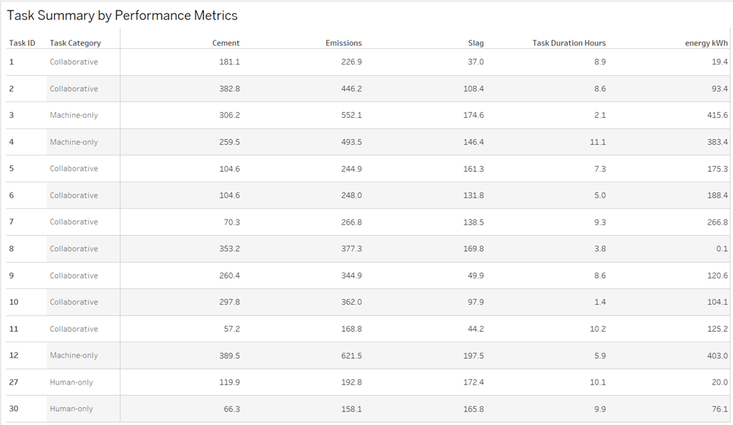
DASHBOARD COMPONENT 1

Slide 5
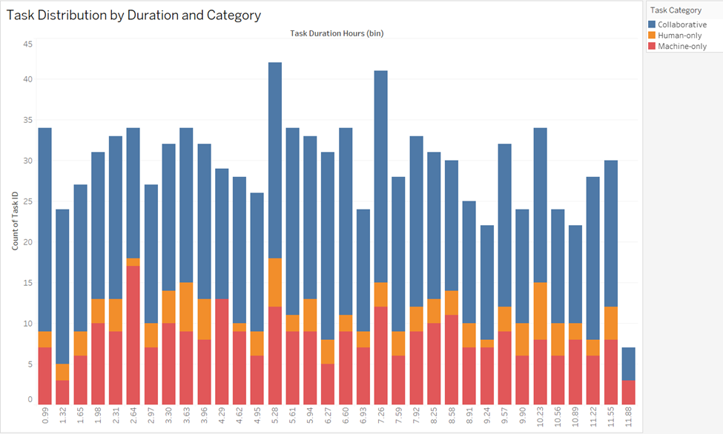
DASHBOARD COMPONENT 2

Slide 6
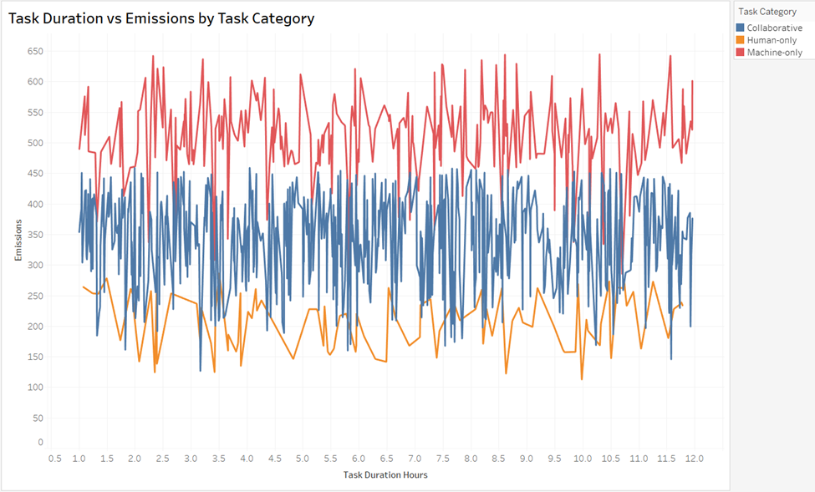
DASHBOARD COMPONENT 3

Slide 7

3 MONTH IMPLEMENTATION ROADMAP
Objective: Deploy MVP, Gather Feedback, Refine Platform
Phase 1: Planning & preparation (1st and 2nd week)
Phase 2: Pilot Testing (weeks 3 -12)
Milestones:
Successful pilot testing with at least 80% user satisfaction
Refined platform ready for full implementation

Slide 8
6 MONTH IMPLEMENTATION ROADMAP
Objective: Roll out platform organization-wide and Monitoring KPIs
Phase 3: Full Implementation (4-6 months)
Milestones:
Platform fully deployed across the organization
At least 15% improvement in task efficiency
Acheive user engagement rate of 85% plus

Slide 9
1-YEAR IMPLEMENTATION ROADMAP
Objective: Scale platform, Optimize AI Insights, Deliver measurable impact on SDGs
Phase 4: Scaling (7-12 months)
Milestones:
Improve task efficiency by 25% compared to baseline
At least 15% reduction in carbon emissions
Expansion of platform usage across all teams globally

Slide 10


FINANCIAL PROJECTIONS
Development COst ($30,500)
AI model development - $15,000
MVP testing & Interation - $5000
UI/UX - $8,000
Backend Infrastructure - $2,500
Deployment Cost ($5,500)
Cloud Hosting - $2,500
API Integration - $3,000
Scaling Cost ($21,000)
Cloud & Hosting Upgrades - $5,000/per year
Maintenence & Updates - $1,000/per year
Operational cost - $15,000/per year
Revenue ($50,000)
Subscriptions Model - $5,000/per client/per year
ROI
Net Profit - $21,000
ROI - 58%
Payback period - 1.2 years

Slide 11

Integration of AI
Potential CHallenges
Change Management and Workforce Adaptation
Security & Privacy
Cost Benefit Analysis & ROI
Data Integration
Ethical Considerations & Bias Detection
Future Enhancements
Predictive Analytics
Future Forecasting
Automated Reporting
Rea-Time Data Tracking
Team Collaboration Features
Environmental Compliance Tracking

Slide 12

Conclusion
The MVP balance is and AI workforce based on carbon emission regulation.
The call to action is for stakeholders to start doing well by doing good.
To maximize profit while having positive environmental impact.

Slide 13
References
Brown, T. (2009). Change by design: How design thinking creates new alternatives for business and society. HarperBusiness.
Cohn, M. (2010). Succeeding with agile: Software development using Scrum. Addison-Wesley Professional.
Kerzner, H. (2017). Project management: A systems approach to planning, scheduling, and controlling (12th ed.). Wiley.
Liao, S., Wang, D., Xia, C., & Tang, J. (2022). China’s provincial process CO2 emissions from cement production during 1993–2019. Scientific Data, 9(1), 165. https://doi.org/10.1038/s41597-022-01270-0
Ries, E. (2011). The Lean Startup: How today’s entrepreneurs use continuous innovation to create radically successful businesses. Crown Business.
Schwalbe, K. (2018). Information technology project management (9th ed.). Cengage Learning.
Tonnquist, B. (2018). Project management: A guide to the theory and practice of project, program and portfolio management, and business change (2nd ed.). Sanoma Utbildning.
OpenAI. (2024). ChatGPT (June 2024 version). Retrieved from https://chatgpt.com/

Slide 14
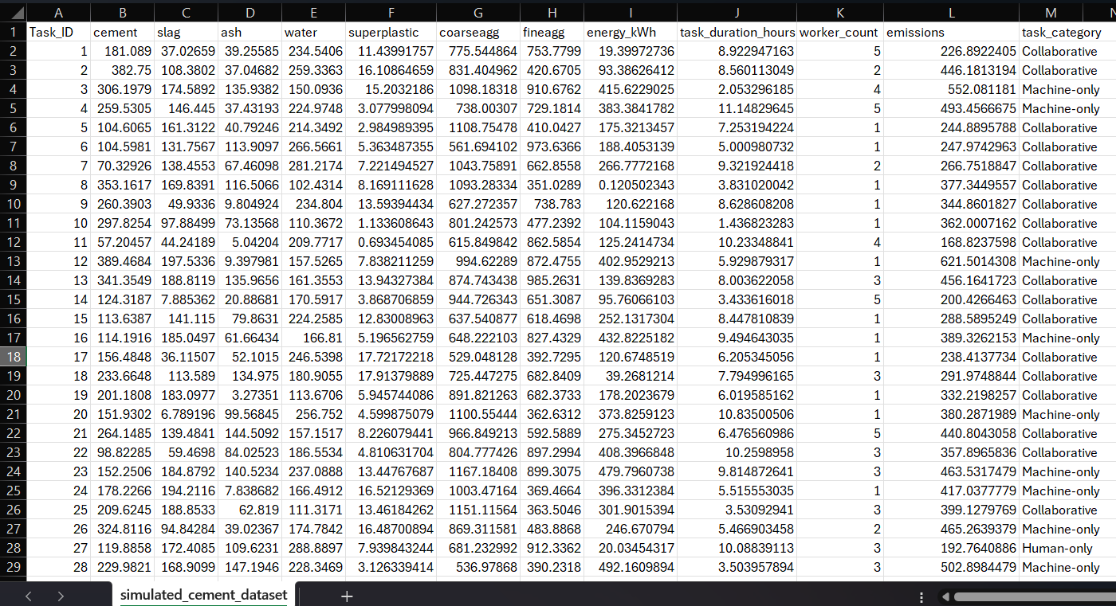
Appendix

